Slide 1


Route ETA Prediction In Singapore
AI for a smooth journey

Slide 2
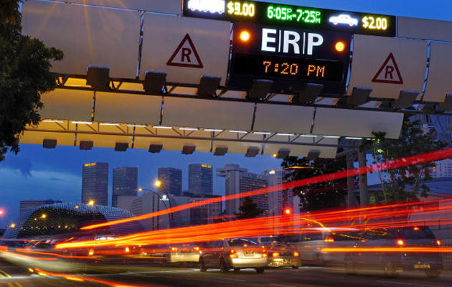
Team benchwarmers
1
Sim Kwong Wui
2
Wee Ming Qiu
3
Low Wei Zeng

Slide 3

Endpoint & scoring functions
The data processing and model is stored at endpoint:
http://41698060-7459-44a9-97d6-6b4da799ad9a.southeastasia.azurecontainer.io/score
We have also prepared a scoring script in order to allow panels to run the model successfully. The full scoring script can be found in Appendix.
In case Azure deployment failed, kindly use this link to access to our final model and scoring file:
https://drive.google.com/drive/folders/10w48TjGGGJe-Fqatr8seuiScOvtWv4eg?usp=sharing
***This slide consists some animations which could be useful for explanation of thought processes. Kindly read in a slideshow.

Slide 4


agenda
1
Problem Statement
2
Prediction Model Design
3
Detailed Analytic Workflow
4
Model Training & Model Deployment

Slide 5
Problem Statement
Longer or unreliable estimated time of arrival could impact both drivers and passengers especially in transportation industry:
Trip cancellations by passengers /drivers
Passenger anxiety when travelling to the destination
Unfair pricing
Challenges for Transport in Developing Cities
Traffic congestion remains a major problem in developing cities in South-East Asia. It causes the estimated arrival times and travel times to be unreliable.
*Ref: Disrupting Mobility: Impacts of Sharing Economy and Innovative Transportation on Cities, Springer ebook.
*Ref:https://www.rappler.com/business/229264-grab-philippines-measures-curb-driver-passenger-cancellations
Impacts to the drivers and Passengers
Here, we will construct a model to predict route ETA in Singapore.

Slide 6




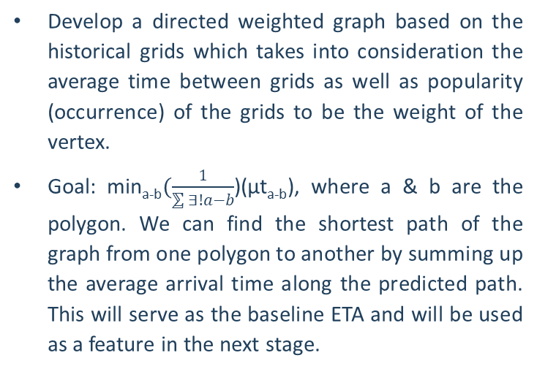
Prediction model Design
Grid Mapping
Approximate Driving Path
Feature Engineering and Modelling
Bin the map using 500m hexagon grids.
Hexagon was used to minimize the distortion in the connectivity of the driving journey.
GPS data points within a grid will be aggregated and average time from one polygon to another can be calculated.
Develop a directed weighted graph based on the historical grids which takes into consideration the average time between grids as well as popularity (occurrence) of the grids to be the weight of the vertex.
Goal: min_{a-b}$(\frac{1}{⅀{∃!a−b}}$)(µt_{a-b}), where a & b are the polygon. We can find the shortest path of the graph from one polygon to another by summing up the average arrival time along the predicted path. This will serve as the baseline ETA and will be used as a feature in the next stage.
Use various network metrics (eg: Centrality) to model the incoming and outgoing vertex to approximate the traffic conditions.
The metrics are used as features together with ETA from previous stage, alongside with other variables such as hour and day to construct the training model.

Slide 7
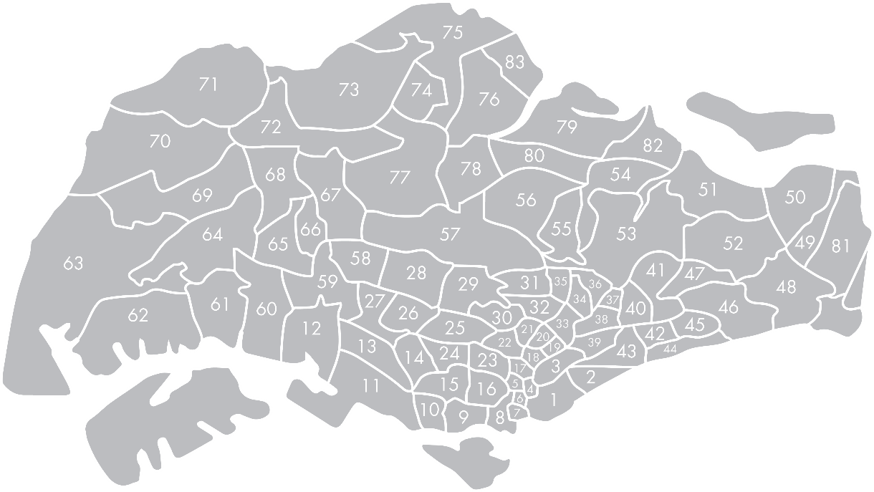
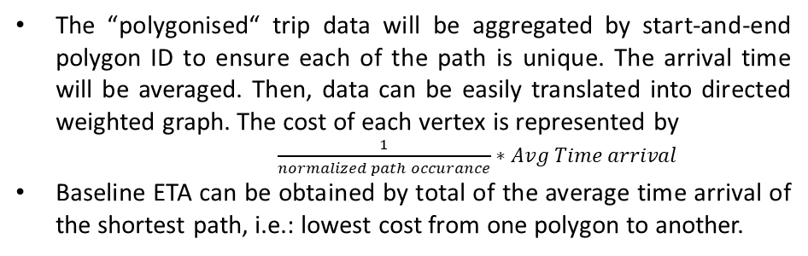
Detailed analytic workflow
Vertex: Attribute A and Attribute B
B
C
A
B
C
A
D
D
E
E
F
G
Attribute A : 1/normalized path occurrence * average time arrival
Attribute B : Average time arrival
Bin the Singapore map into 500X500m hexagon.
Each of journey will be aggregated within its respective polygon to represent the movement in polygon, instead of GPS points.
The time arrival will be calculated by taking the difference between the minimal time of previous polygon and the time of the next polygon.
The “polygonised“ trip data will be aggregated by start-and-end polygon ID to ensure each of the path is unique. The arrival time will be averaged. Then, data can be easily translated into directed weighted graph. The cost of each vertex is represented by
$\frac{1}{normalized path occurance}∗Avg Time arrival$
Baseline ETA can be obtained by total of the average time arrival of the shortest path, i.e.: lowest cost from one polygon to another.

Slide 8
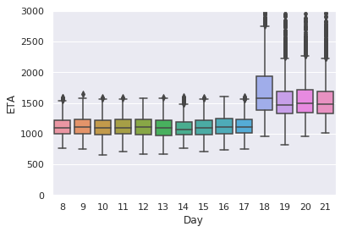
Detailed analytic workflow
B
C
A
D
E
F
19 April is Good Friday, 20 and 21 April are weekend.
If take leave on Thursday, then it will become a four consecutive holidays.
G
Based on our EDA, we observe that public holidays have significant impact on ETA. Some routes near to Singapore border and Changi Airport has longer ETA on Friday. Hence, some date/time related features are created to improve the model performance.
One of the main factors that affects route ETA is the traffic condition of the chosen path (from polygon A to B), given the same pickup and destination point.
Hence, various network metrics are calculated to approximate the traffic condition i.e.: centrality.
Here, we made assumption that high in-out flow polygons might require longer travel time.

Slide 9
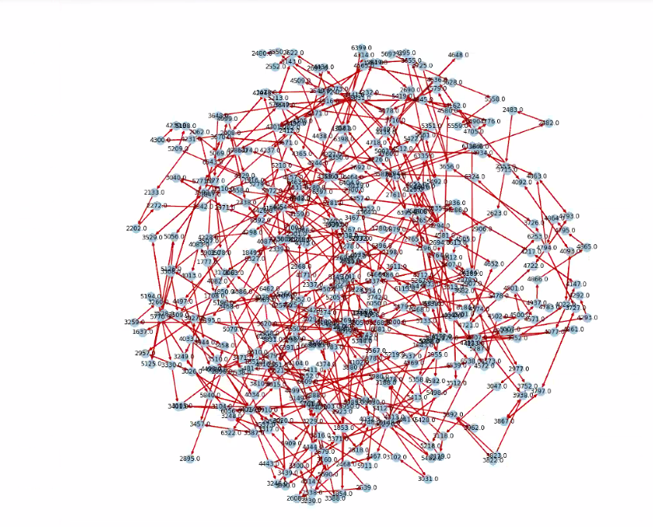
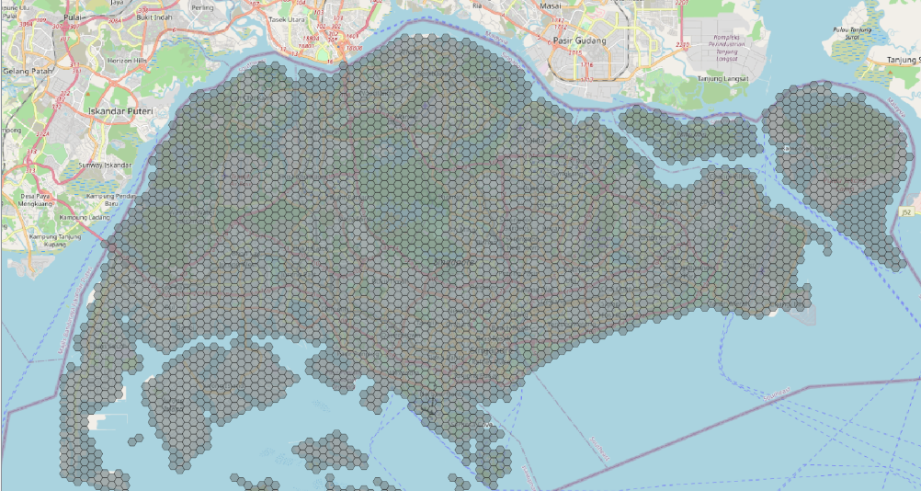
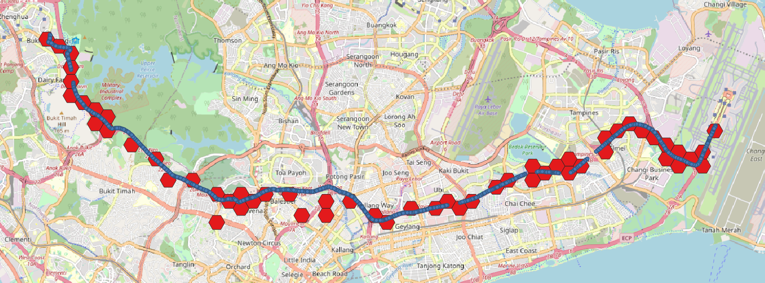
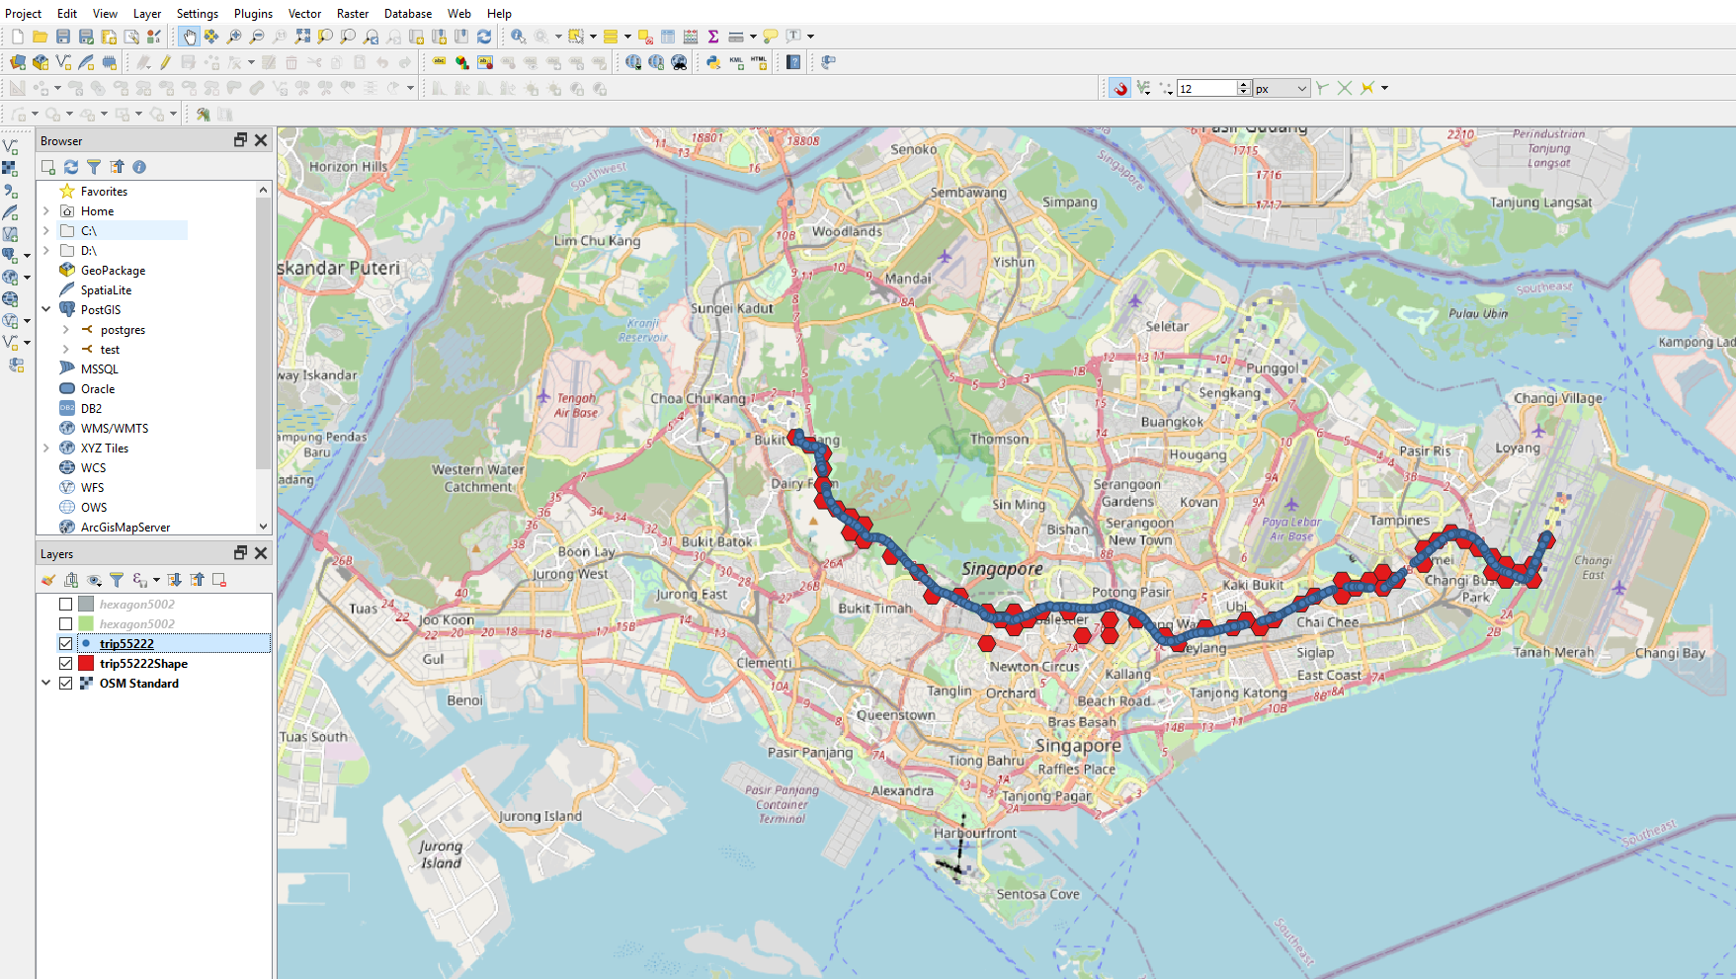
Example Output: Grid Mapping & Approximate Driving Path
Directed Weighted Graph
Grid Mapping
Actual vs Estimated Path
Actual
Actual ETA : 20mins
Baseline ETA : 24mins
Predicted ETA : 21mins
Predicted

Slide 10
Model TRAINING PROCESS
External data usage & Feature creation:
External data 1: Public holiday data (year 2019) scraped from https://www.timeanddate.com/holidays/singapore/
External data 2: Weather data scraped from https://www.timeanddate.com/worldclock/singapore/singapore
Estimation of ETA for each route is calculated
Various Network metrics
Model training:
Split data into 2 parts (7:3) – 70% is used as training data & 30% is used as testing data
Used Bayesian Optimization and 2 folds cross validation(training) to optimize various models such as RandomForest, XGBoost and LightGBM.
Selected LightGBM as final model as it provided lowest RMSE in test score.
Model testing:
From the test data set, we are able to achieve RMSE = 204

Slide 11
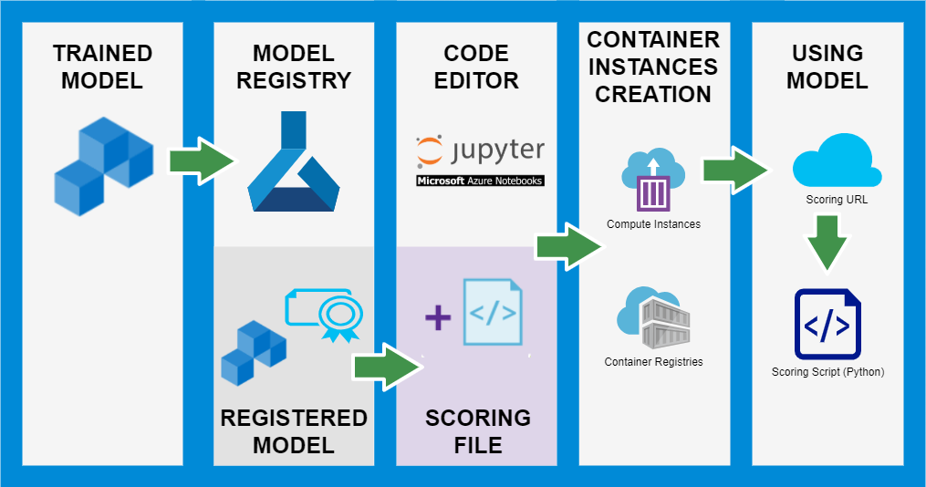
Model DEPLOYMENT
Here’s an overview of pipeline how of creation and deployment of model in Azure Machine Learning Service.
For prediction of new tracks (for Singapore), kindly refer to scoring script which consists of endpoint & procedure to use the model with specified data format input.

Slide 12
APPENDIX
Script snippets (for scoring)

Slide 13
Scoring function
import json
import requests
import pandas as pd
#conversion to pandas
def conv_(ch):
res = ch.strip('][').split(', ')
res = [s.strip('["]') for s in res]
res_pd = pd.DataFrame(res)
res_pd.columns = ['pred']
res_pd['pred'] = pd.to_numeric(res_pd['pred'])
return res_pd
#scoring function
def score_url(df):
# URL for the web service.
scoring_uri = 'http://41698060-7459-44a9-97d6-6b4da799ad9a.southeastasia.azurecontainer.io/score'
# Convert to JSON string.
input_data_json = df.to_json()
# Set the content type.
headers = {'Content-Type': 'application/json'}
# Make the request and display the response.
resp = requests.post(scoring_uri, input_data_json, headers=headers)
# print(resp.text)
pred = conv_(resp.text)
return pred
#scoring function - by batch of 1000
def score_batch(df):
pd_all = pd.DataFrame()
if df.shape[0]>1000:
for i in range(1,len(df)//1000+1,1):
a = 1000*(i-1); b = i*1000
temp = df.iloc[a:b,:]
pred_temp = score_url(temp)
pd_all = pd.concat([pd_all, pred_temp], axis = 0)
else:
pd_all= score_url(df)
return pd_all
# KINDLY KEY IN THE DIRECTORY - Load the data from CSV (in pandas format)
inp = ""
data = pd.read_csv(inp+'sample_all.csv')
sample = pd.read_csv(inp+'sample.csv') #IMPORT THE SAMPLE
target = pd.read_csv(inp+'target_all.csv')
test_all = score_batch(sample)
# Calculation of RMSE
from sklearn.metrics import mean_squared_error
mean_squared_error(test_all.pred,target["eta"])**0.5

Slide 14

Thank you

